Slide 1
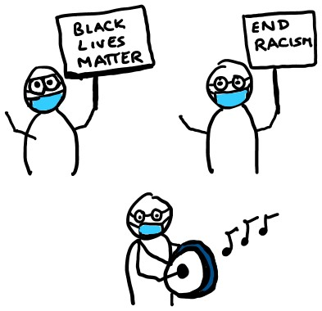
HARM REDUCTION FOR PROTESTS IN A PANDEMIC
stay home if sick
wear a mask and eye protection
maintain distance from others and keep interactions short
carry hand sanitizer
yelling can spread droplets; use signs, drums, or other noisemakers
stick with a buddy group to keep your unknown contacts low
quarantine for 14 days afterwards, if possible
@EpiEllie + @JuliaLMarcus

